Slide 1
Credit Card Churn
$
Team Name: Almond Pistachio

Slide 2
Table of contents
01
04
02
05
03
06
Returning Customer
Business Problem
Insights
Predicting Churn
Attrited Customer
Marketing Campaigne

Slide 3
01
Business Problem
$
$

Slide 4
Goals
Understand retention Factors
Understand Churn factos
Reduce Churn and improve retention
Who are the attrited customers?
How can we predict churn?
Who are our most loyal customers?
Why?
How to stop customers from leaving and keep them coming back?

Slide 5
02
Insights
$
$

Slide 6
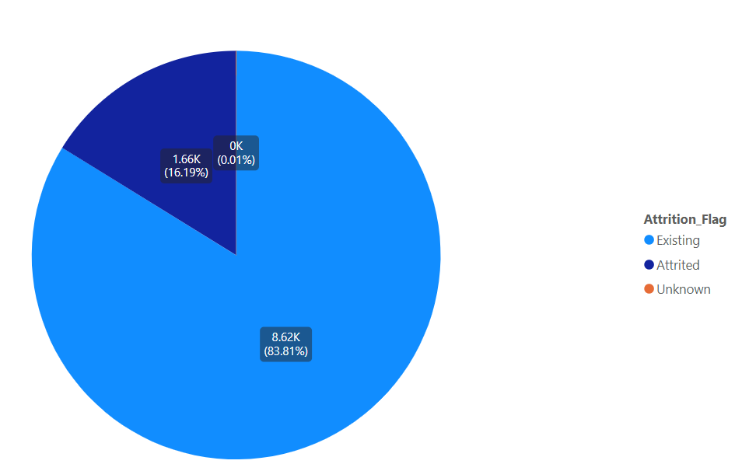
Existing Vs Attrited

Slide 7
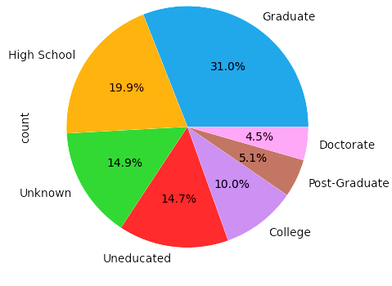
Education Level
Notes:
70% of customers are educated. About 30% assumed uneducated.

Slide 8
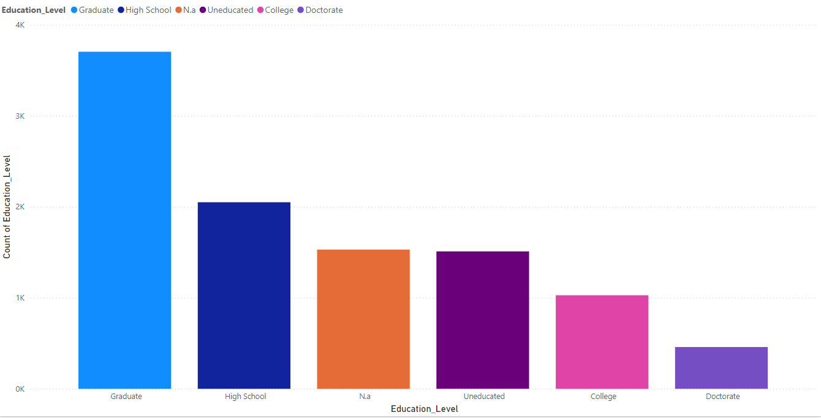
Education Level
Notes:
70% of customers are educated. About 30% assumed uneducated.

Slide 9
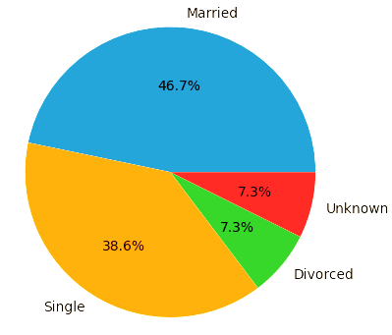
Marriage Status
Notes:
70% of customers are educated. About 30% assumed uneducated.

Slide 10
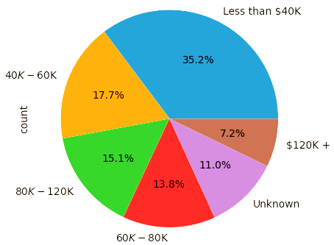
Income Categories
Notes:
Majority less than 40K to 60K

Slide 11
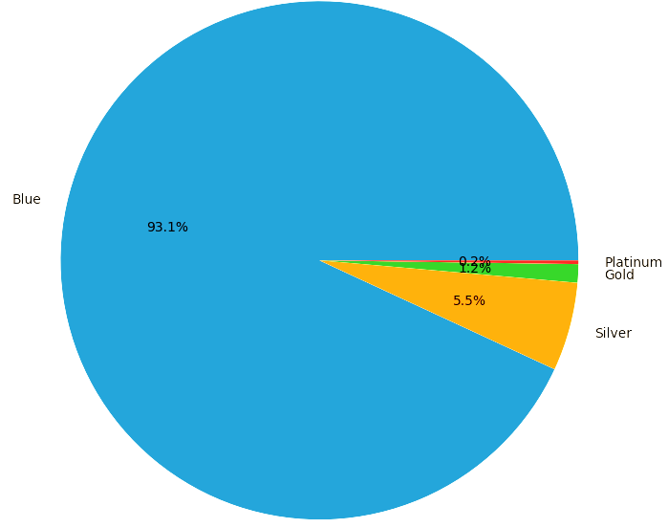
Income Categories
Notes:
Majority less than 40K to 60K

Slide 12
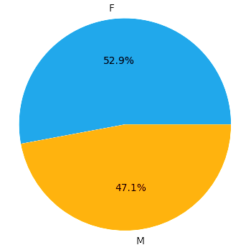
Gender
Notes:
Majority less than 40K to 60K

Slide 13
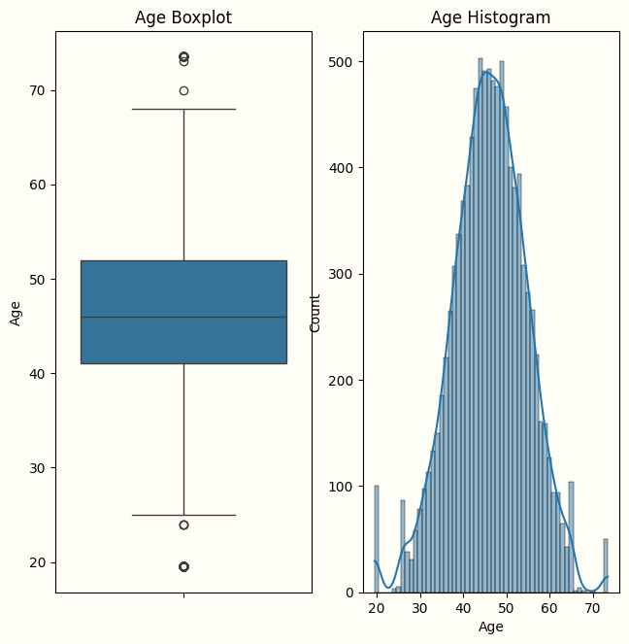
Age Distribution
Age is normally distributed with some outliers.
Average age is 46.1

Slide 14
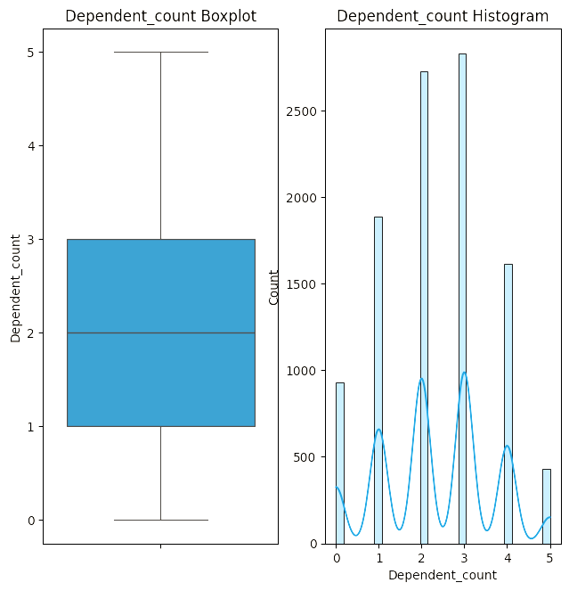
Dependent Count Distribution
The most common number of dependents is 3
The median number of dependents is 2

Slide 15
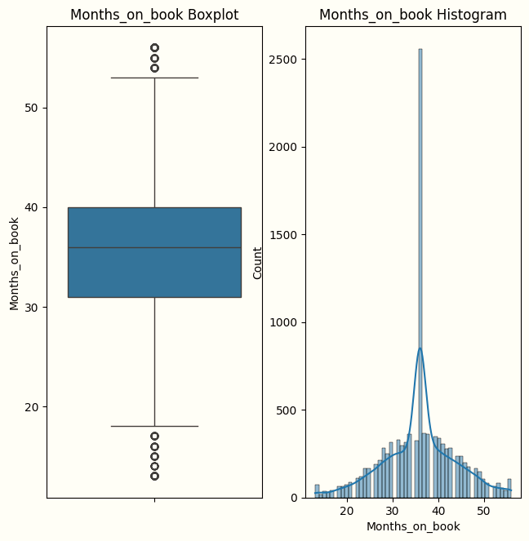
Months on Book Distribution
The number of months customers had their credit card open range from 13 to 56 months
The most common number of months is 35.9

Slide 16
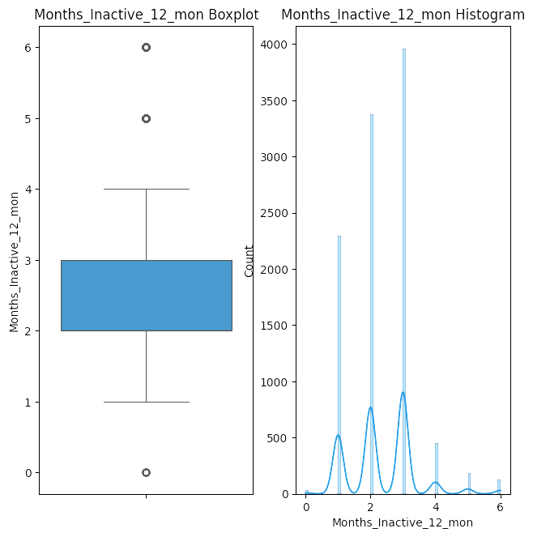
Months Inactive Distribution
In the last 12 months most customers were inactive for 3 months

Slide 17
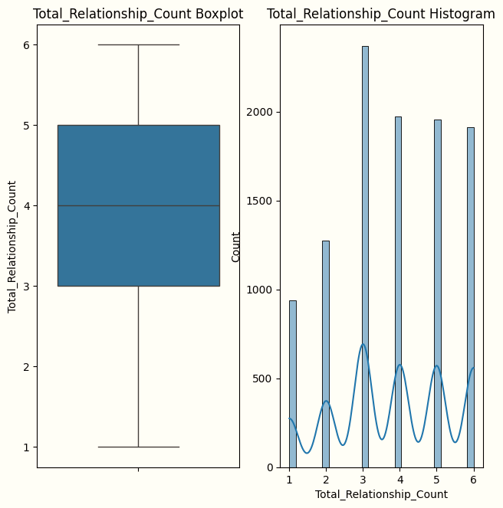
Total Relationship Count Distribution
Majority of Customers hold 3 products offered by the bank.
The least number of products held is 1 and the most is 6

Slide 18
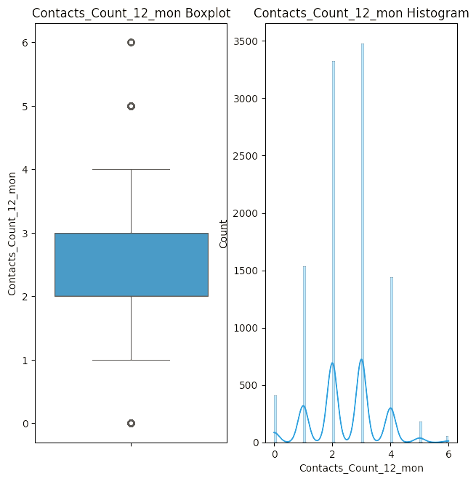
Contacts Count Distribution
Majority of Customers have contacted the bank 3 times in the last 12 months.
The number of contacts range from 0 to 6.

Slide 19
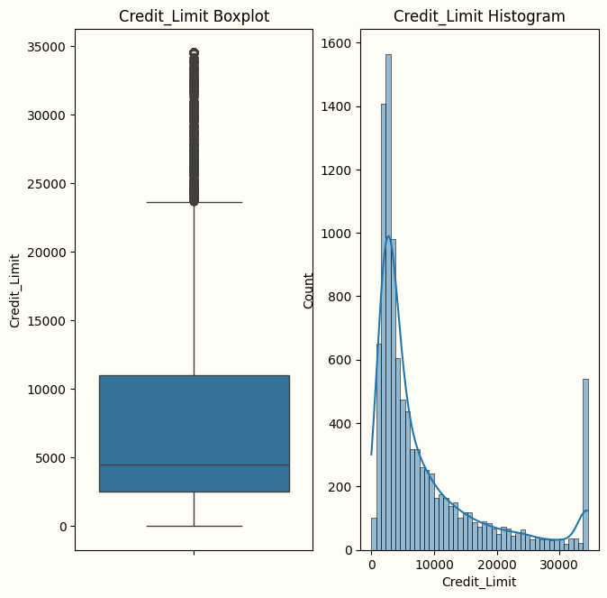
Credit Limit Distribution
Credit Limit is heavily right skewed with large number of outliers.
Most customers have lower credit limit with a few exceptions.
Notes:
Low credit limit due to most customers being from lower income categories

Slide 20
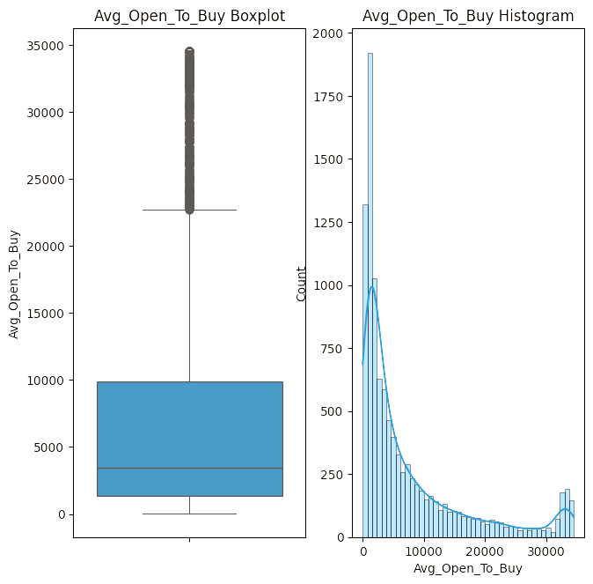
Average Open to Buy Distribution
Defined as how much credit the customer has available to use.
The distribution is very similar to credit limit

Slide 21
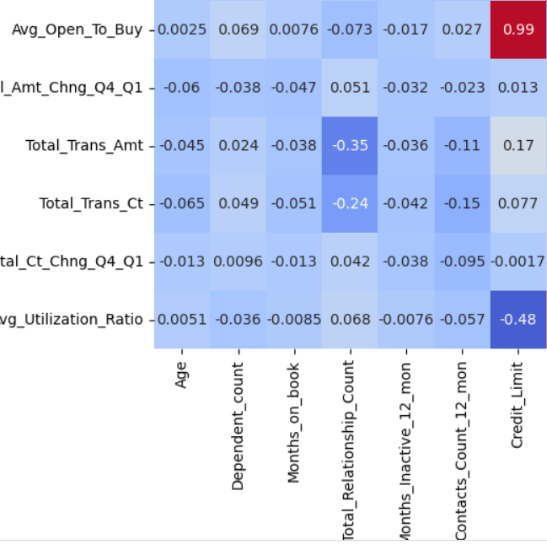
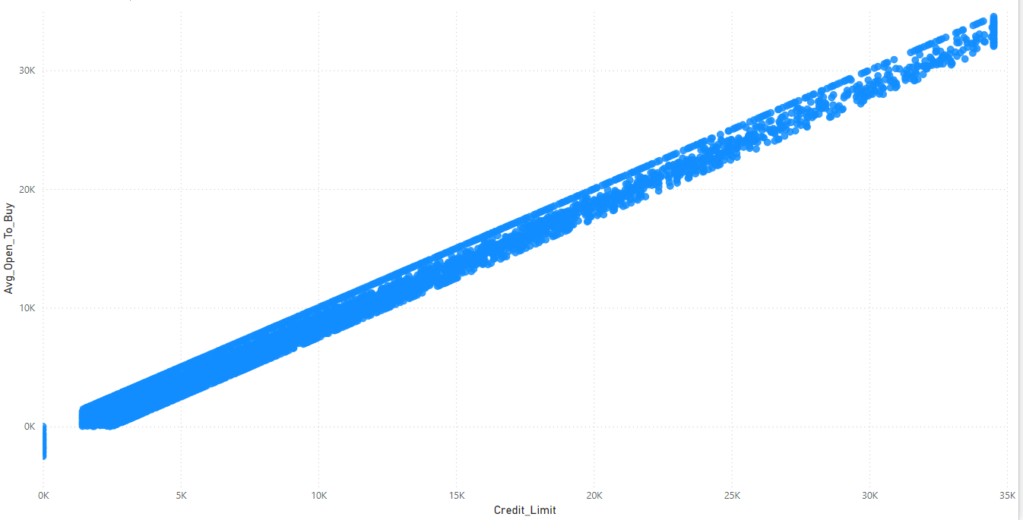
Credit Limit and Avg Open to Buy
This figure from the correlation matrix shows that credit limit and AOTB have a correlation of 0.99.
Notes:
This makes sense as credit limit is the maximum credit but AOTB is the actually available credit

Slide 22
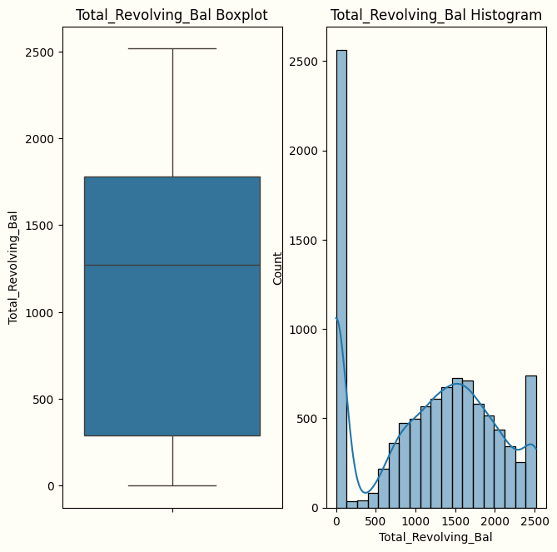
Total Revolving Balance Distribution
It represents the unpaid portion of the credit card balance that is subject to interest charges.
Most customers have lower total revolving balance.

Slide 23
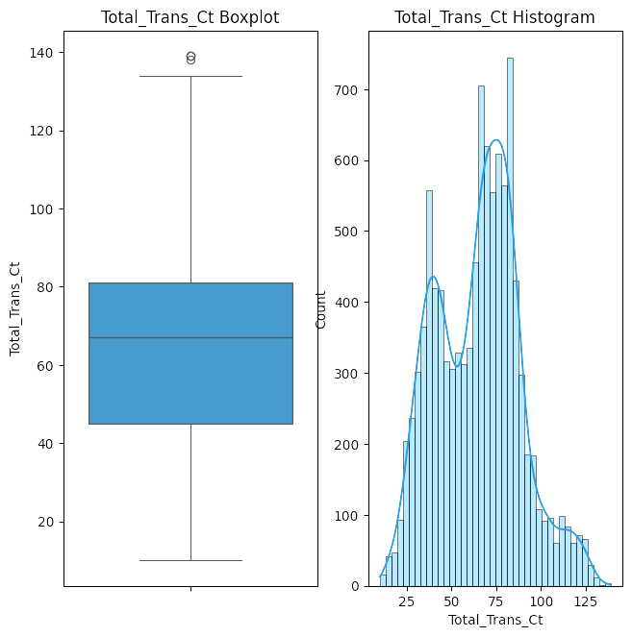
Total Transaction Count Distribution
Most customers made between 45 to 80 total transactions in the last 12 months.

Slide 24
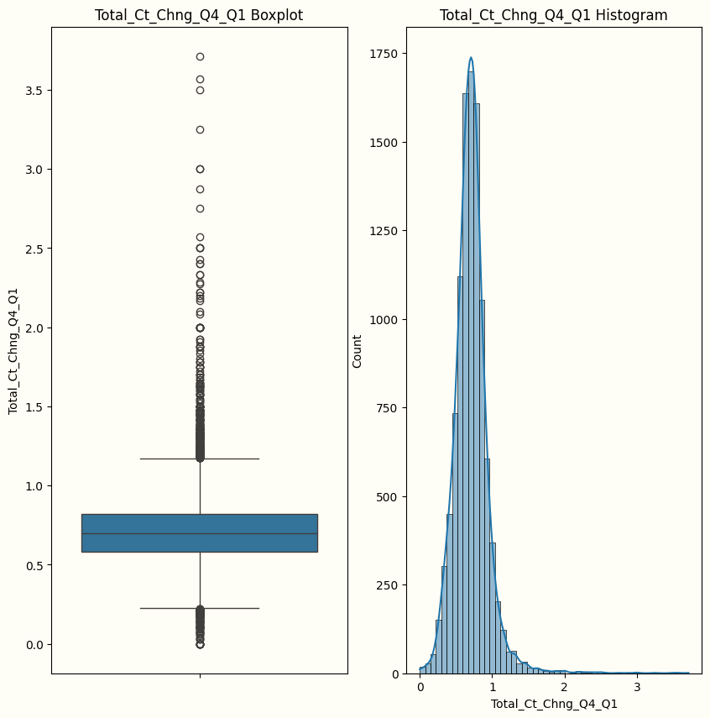
Transaction count change from Q1 to Q4 Distribution
The majority of customers have had a change between 0.5 and 1 from Q1 to Q4 in the number of transactions
On Average a change of 0.71 was observed

Slide 25
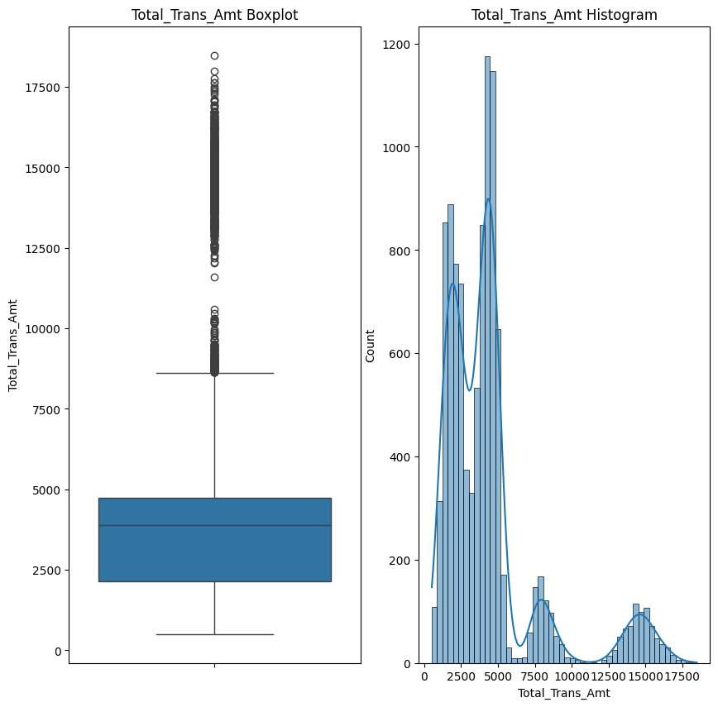
Total Transaction Amount Distribution
There is a large variation in the data as it has a standard deviation of 3395
A large portion of the data is concentrated between 2500 and 5000
Notes:
Different peaks suggest the need to segment the data according to the different transactions. 2nd point due to large portion of the customers being from lower income category

Slide 26
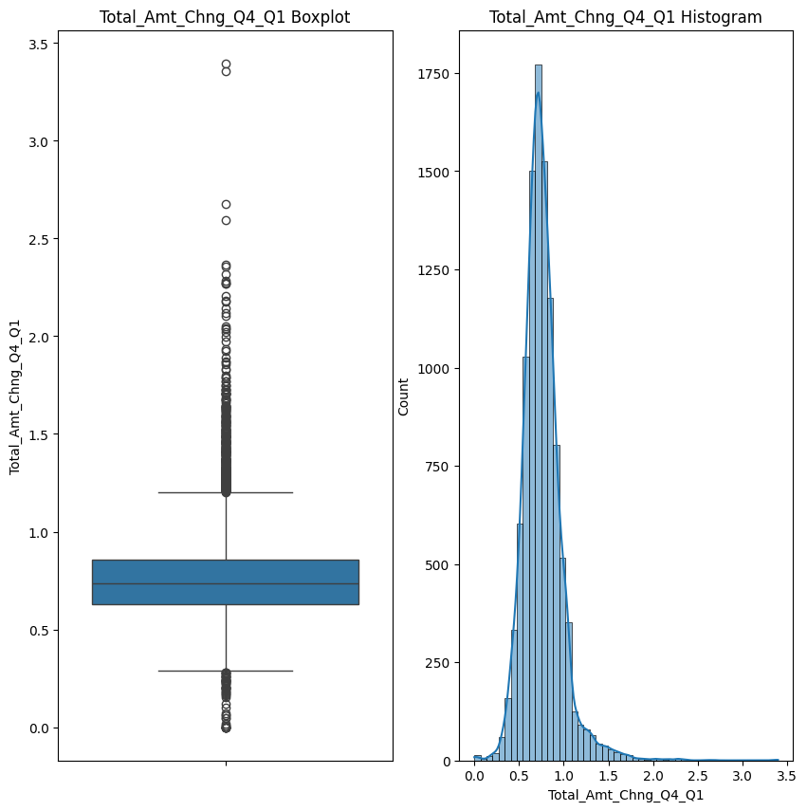
Transaction amount change from Q1 to Q4 Distribution
The transaction amount is relatively stable with an average of 0.76 change from Q1 to Q4
Large number of outliers
Notes:
The outliers could be linked to real life reasons why someone’s transaction amount could change, such as raises, different economic circumstances. Bonuses etc.

Slide 27
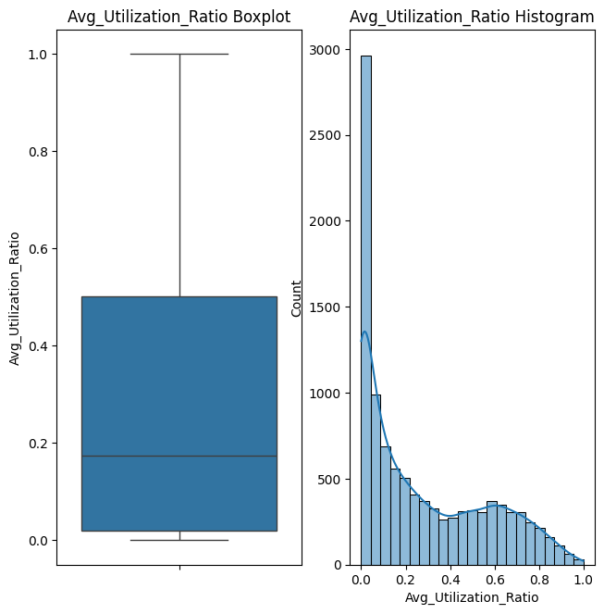
Average Utilization Ratio Distribution
It is how much of the available credit is the customer using on average.
High number of customers have lower utilization ratios which suggests inactivity.
Notes:
The outliers could be linked to real life reasons why someone’s transaction amount could change, such as raises, different economic circumstances. Bonuses etc.

Slide 28
03
Attrited Customer
$
$

Slide 29
Understanding the Attrited Customer
Demographic
Analysis
Financial Analysis
Behavioral Analysis
Age
Marital Status
Education Level
Income
Balance
Credit Limit
Months on Book
Inactivity
Contact Frequency

Slide 30
Demographic Analysis

Slide 31
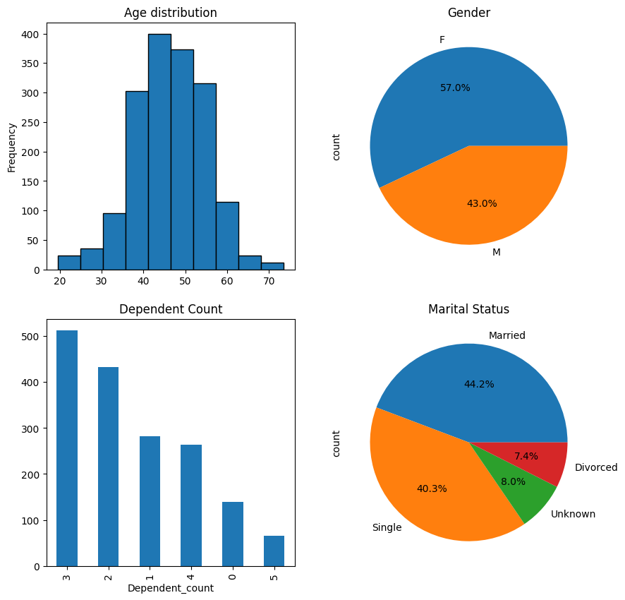
Average age is 46
Majority female
Majority Married
Majority have 3 dependents
Notes:
Similar to full data

Slide 32
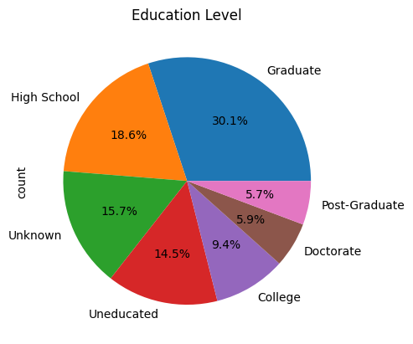
70% are educated

Slide 33
$
$
Financial Analysis

Slide 34
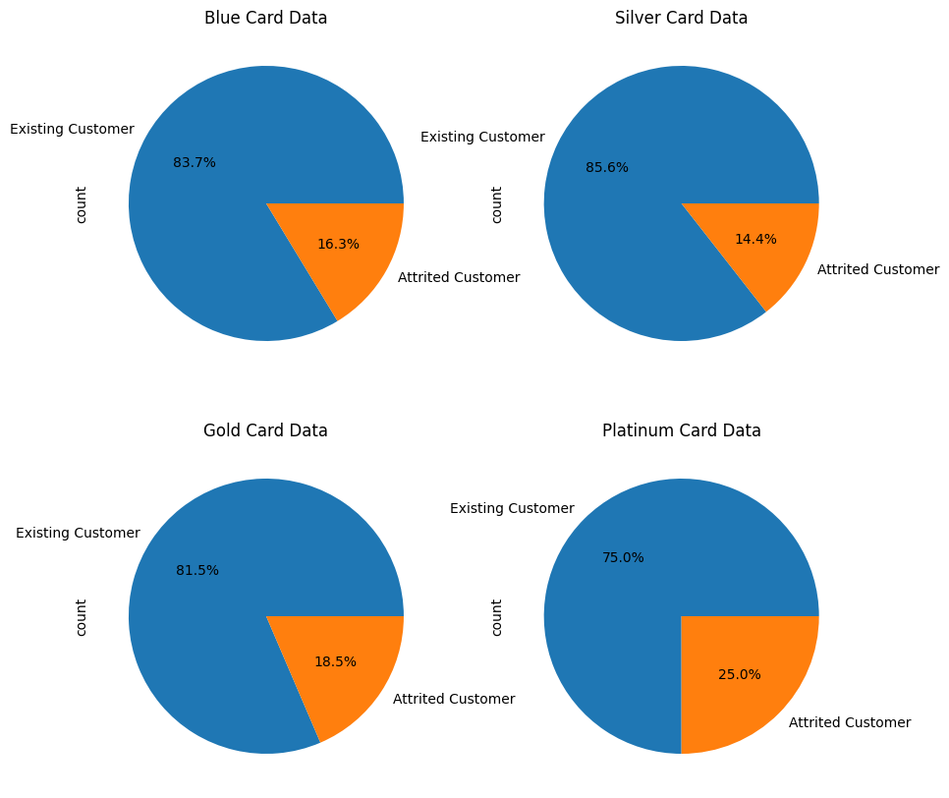
Larger Proportion of Attrited customers with Platinum cards

Slide 35
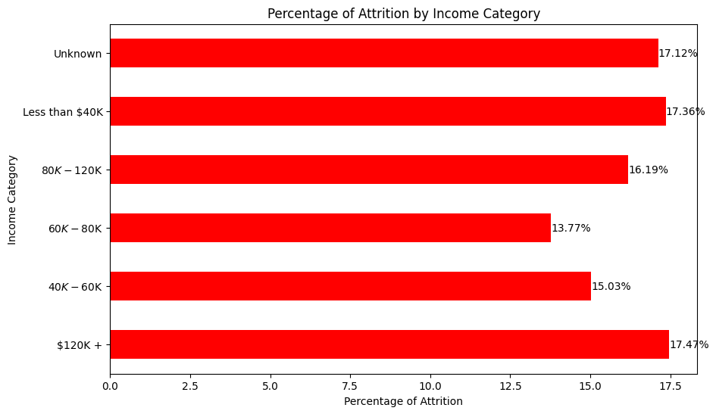
Largest Percentages of attrition in the highest and lowest income categories
Notes:
Not meeting the needs of the highest income category of the least. Only the middle

Slide 36
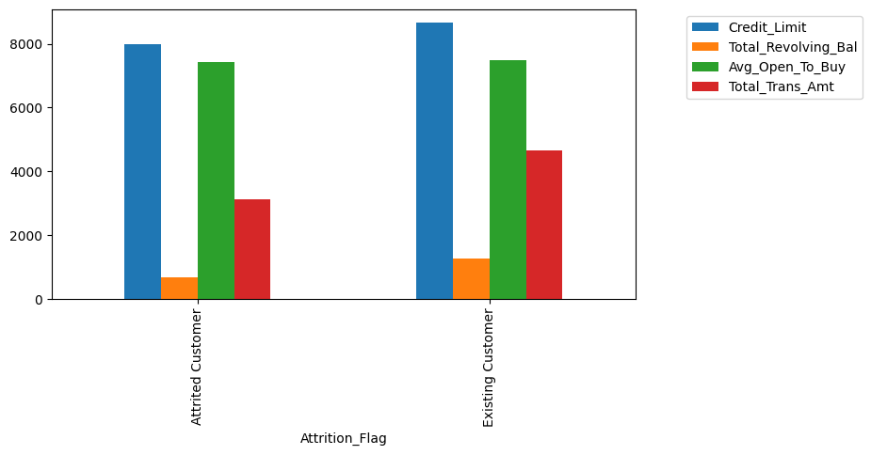
Existing customers have higher average credit limit as well as Total Transaction amount and revolving balance.
This suggests that attrited customers likely left because of a lack of trust in the bank.
Notes:
Many attrited customers were from high economic category, them having lower credit limits than existing could be a reason as the customers don’t feel satisfied by the limits the bank has imposed on them.

Slide 37
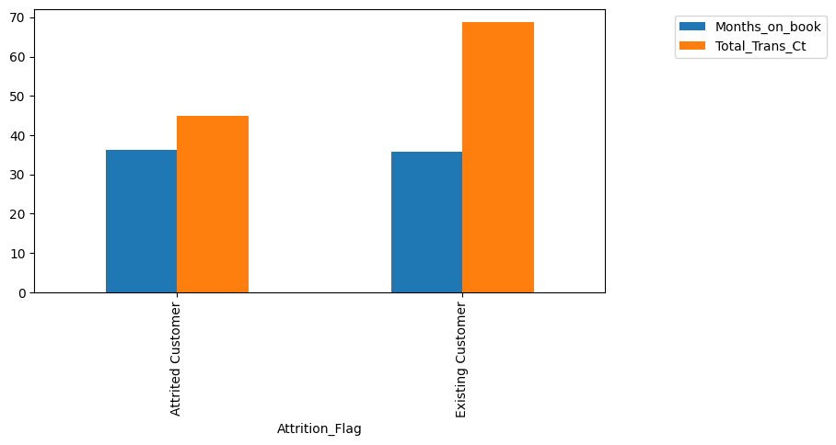
This shows that on average both existing customers and attrited have the same number of months on book
Attrited customers have made significantly less total transactions in the last 12 months.

Slide 38
$
$
$
Behavioral Analysis

Slide 39
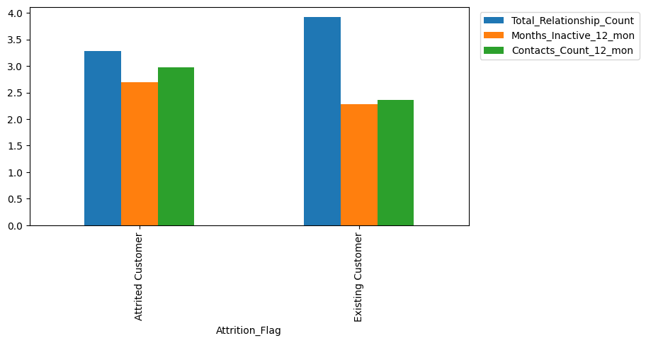
Existing Customers are satisfied with the service they receive so they have higher total relationship count and lower periods of inactivity.
Attrited customers have contacted the bank more in the last 12 months suggesting they have had more complaints that weren’t addressed

Slide 40
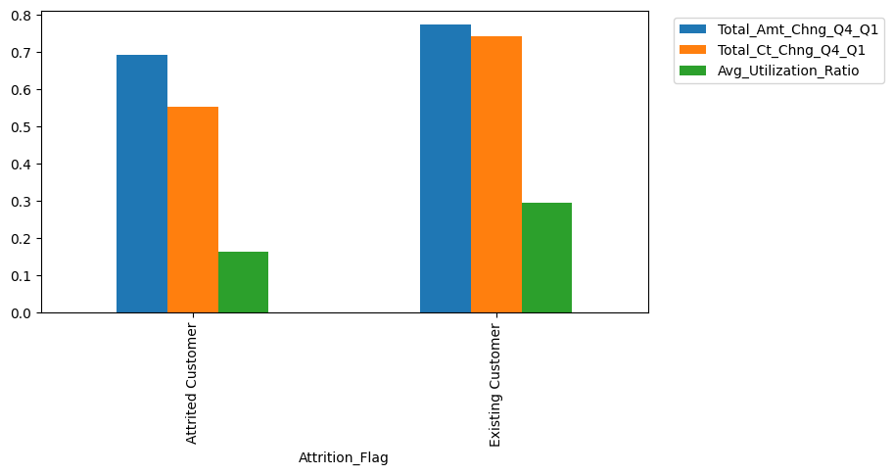
There is a more significant positive change in the average frequency and amount of transactions among existing customers.
Attrited customers have lower utilization ratios.
Notes:
Potentially means that whatever complaints they’ve made through frequent contact with the bank was not addressed. Even at the end of the year.

Slide 41
Factors of Churn
$
According to the previous analysis
Unsuitable Credit Limit relative to income
Issues with Gold and Premium card
Ineffective Customer Support
Customers’ Complaints are left unaddressed for a long time
Highest and Lowest income categories are not properly targeted.
$

Slide 42
04
Returning Customers
$
$

Slide 43
What is a returning customer?
Customer with above average:
Average Utilization Ratio
Total Relationship Count
Transaction Count in the last 12 months
Customer with below average:
Months of inactivity

Slide 44
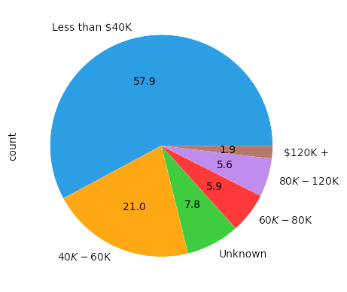
Income Categories of Returning Customer
Notes:
Some of the most loyal customers and the 2nd least most common in attrition are less than 40K. This suggests wrong segmentation.

Slide 45
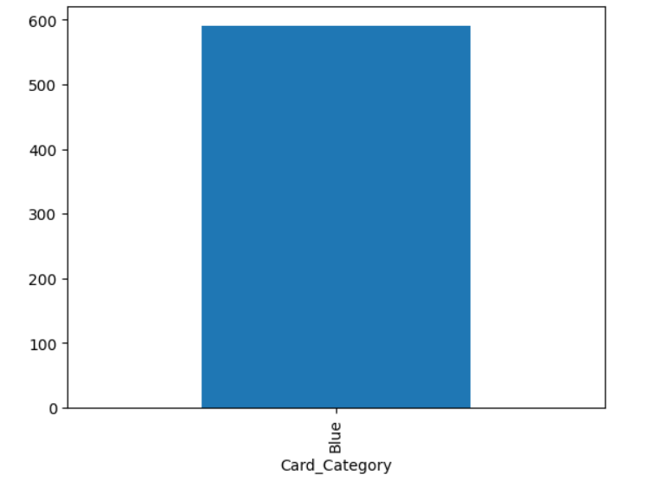
Card Category
2754
Average Credit Limit
Notes:
This suggests that the blue card is the most useful all the other upgrades are not as useful work on that

Slide 46
How to reward Returning Customers
Loyalty Programs (Points, Vouchers, Discounts)
Chance to upgrade to higher card categories after certain period and number of products with the bank
Attractive installment programs for major purchases (Cars, Houses)

Slide 47
05
Predicting Churn
$
$

Slide 48
Goals
Understand Features Importance
Predict New Customers Behavior
Choose the Best Model for Predictions
Preprocess the data for training the models.
Test different models.
Check the possibility of prediction churn with the provided features.
Do predictions on new customers to reduce churn rate.

Slide 49
Preprocess the Data
For the model to be efficient, data needs to be cleaned and preprocessed.
Remove Duplicates:
- The data have some duplicates in the Customer_Number column, and some rows share exactly
the same data but with different Customer_Number.
- These duplicates are removed by ensuring no valuable data is lost, and only the duplicate entry
that have some unknown values are the one to be dropped.

Slide 50
Preprocess the Data
For the model to be efficient, data needs to be cleaned and preprocessed.
2. Check Correlation:
- The correlation determine how every two columns are related to each other, if the number R is
is above 0.8 or below -0.8, then it’s a strong correlation.
- A strong correlation means that both features share the same value, and one of them can be
without loosing valuable data.

Slide 51
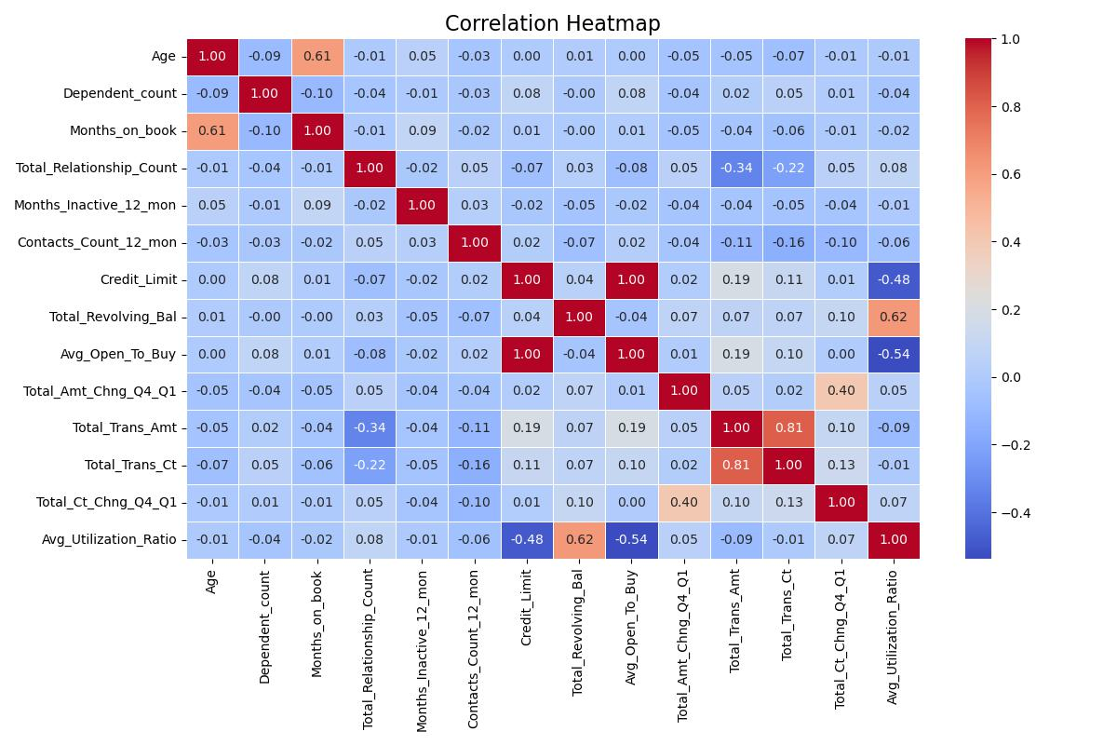
Preprocess the Data
2. Check Correlation:

Slide 52


Preprocess the Data
3. Normalize Numeric Features:
- Rescale numeric features so that they fail within reasonable range.
- A simple normalizing technique is subtracting the mean and dividing by the standard deviation
so that all features have a mean of 0 and standard deviation of 1.
- Here is a code snap showing normalization of a subset of data:

Slide 53
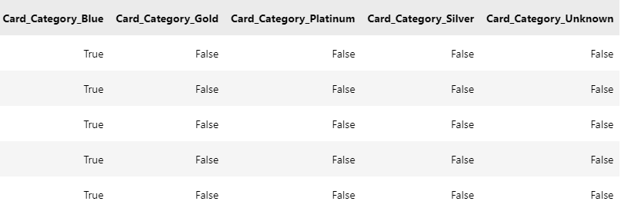
Preprocess the Data
4. Create Dummy Variables:
- Convert categorical features to dummy features which have a value of either True or False,
which can be converter to 1 or 0.
- Here is a code snap showing creating dummy variables of a subset of data:

Slide 54
Preprocess the Data
5. Split the Data into Training and Testing sets:
- We need to do that step so that after building a model, we need to verify the model performance
using some unseen data that we took from the original data.
- Note that we shouldn’t normalize the numeric data before splitting, to avoid data leakage.
- Here is a code snap of splitting the data:

Slide 55


Logistic Regression Model
This model is used for binary classification, which is our case.
The model predicts the probability of the target based on the input features, if the probability is above a given threshold (0.5 for example), then the label is 1, and the label is 0 otherwise.
Here is a code snap of building the Logistic Regression Model with a Grid Search:

Slide 56
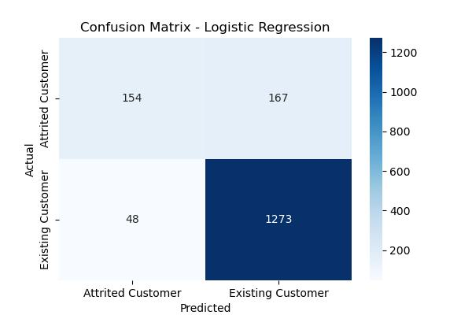
Logistic Regression Performance

Slide 57
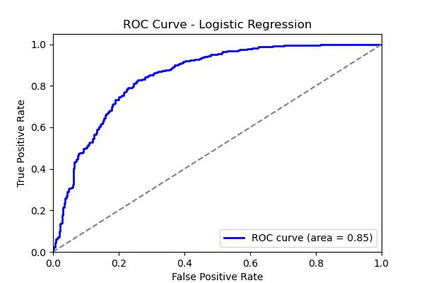
Logistic Regression Performance

Slide 58
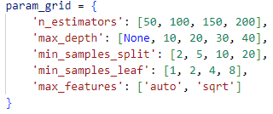

Random Forest Model
This model is used for both classification and regression, but here, it is a classification model.
Here is a code snap of building the Random Forest Model with a Grid Search:

Slide 59
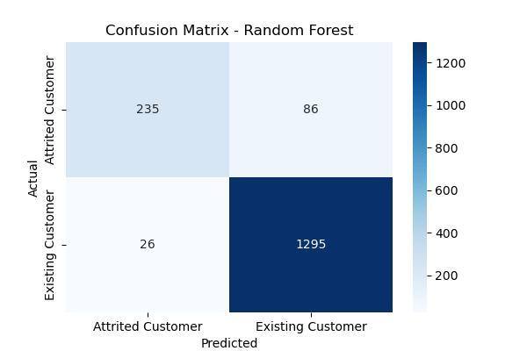
Random Forest Performance

Slide 60
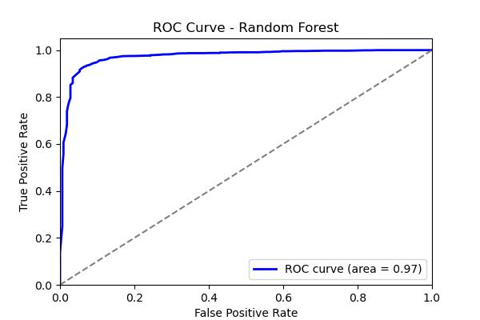
Random Forest Performance

Slide 61
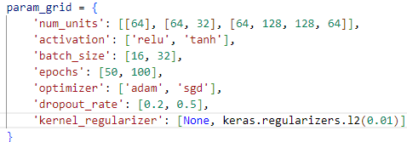
Neural Network Model
The neural networks is a strong model that can be used for all different tasks, but it’s hard to design it’s architecture in a good way, and it’s so complex to explain it’s parameters.
Here is a code snap of building the Neural Network Model with a different combination of parameters to determine the best:

Slide 62
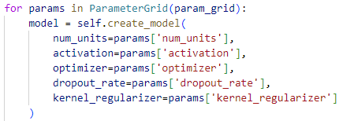
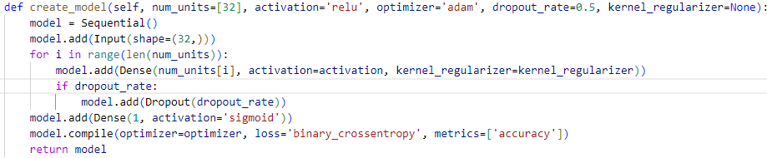
Neural Network Model

Slide 63
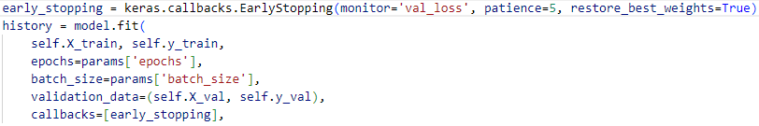

Neural Network Model

Slide 64
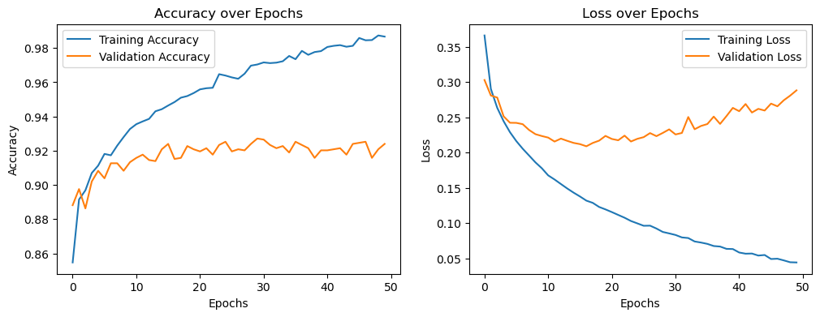
Neural Network Performance without Regularization or Dropout

Slide 65
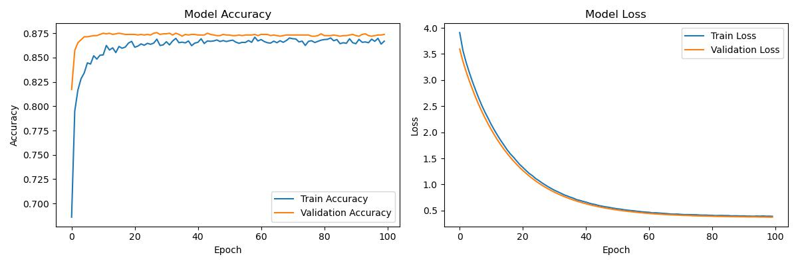
Neural Network Performance with Regularization and Dropout

Slide 66

Neural Network Performance

Slide 67
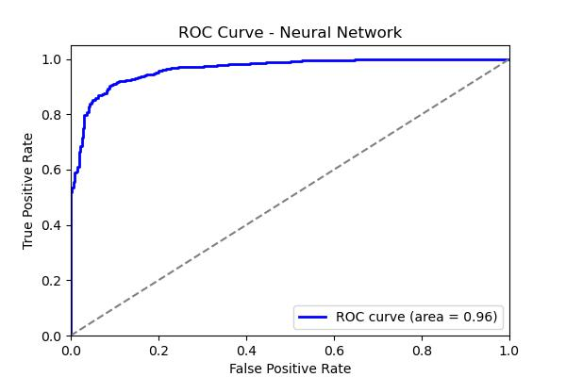
Neural Network Performance

Slide 68
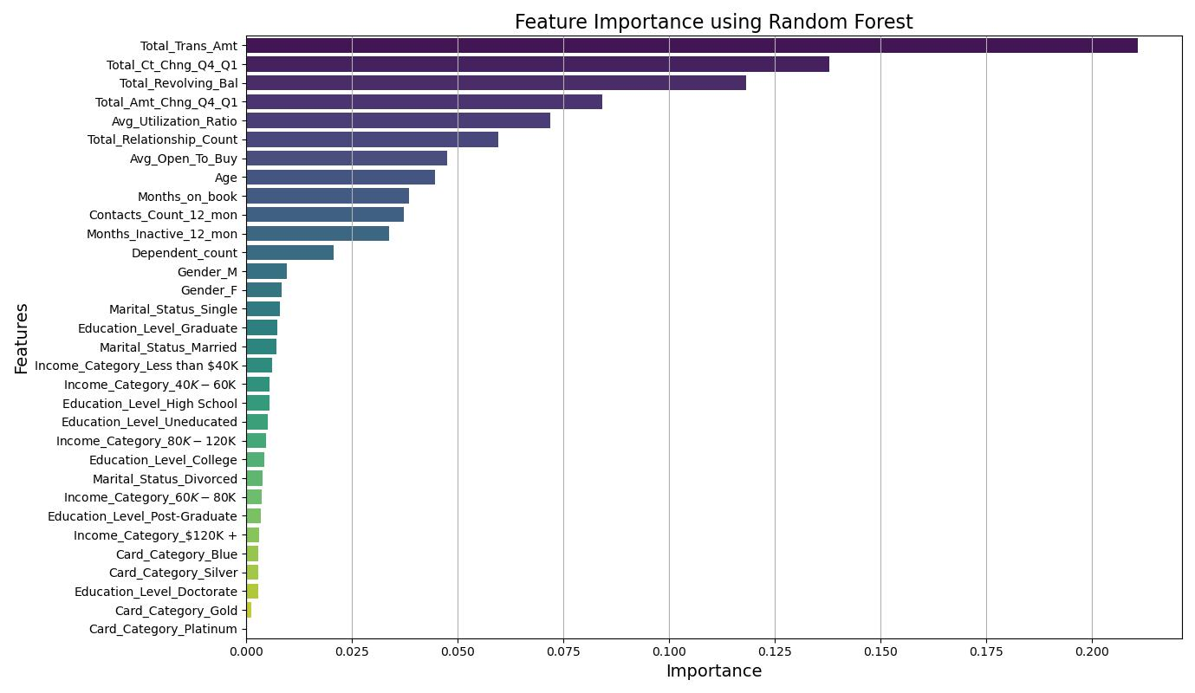
Random Forest Feature Importance
We can use the Random Forest model to understand which features share more in explaining the variance in the target labels.
This can help us gain insight over which customer behavior can be used to predict churn.

Slide 69
Predict New Customers Behavior
After building and testing the models, we find that the random forest model have the best performance over the other two models.
Now we can use this model for predicting which customer are more likely to churn and reduce churn rate ahead of time.

Slide 70
06
Marketing Campaign
$
$

Slide 71
Marketing Strategy
Segmentation and Personalization:
Reassign customers to segments based on personalized offers this will help eliminate some incorrectly segmented individuals.
Channel: SMS, Email
2. Targeting Higher Income Customers:
Card Categories (silver, gold and premium) represent a tiny percentage compared to blue. Probably because they don’t offer attractive enough benefits for customers to be encouraged to upgrade.
Offer exclusive offers and benefits to those who choose to upgrade like access to VIP airport lounges etc.
Channel: Targeted ads on social media, Customer Support

Slide 72
Marketing Strategy
3. Create a new brand image for the bank
The brand needs to maintain a balance between luxury and exclusivity as well as support and reliability for their lower income customers. There needs to be something for everyone that the bank can offer.
The new image needs to also reflect that the bank cares about its customer’s needs more than anything. This needs to be accompanied by enhanced customer support, and faster more efficient follow-ups to complaints.
Channel: Targeted ads on social media, TV ads, Customer Support

Slide 73
KPIs
Redemption Rates for offers, coupons etc.
Engagement Rates on Ads
Customer satisfaction score through surveys
Rate of customers that upgrade to a higher card category
Number of transactions before and after campaign

Slide 74


Thank you
Presented to you by:
Omar Araby
Mariam Hany
Moustafa Saroo
Ali Ashraf

